Slide 1
Recognition Rate

Slide 2
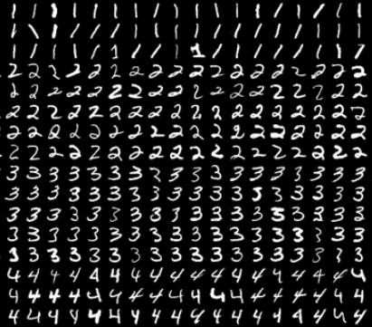
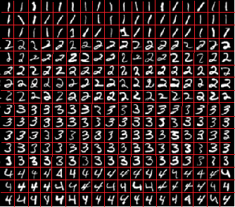
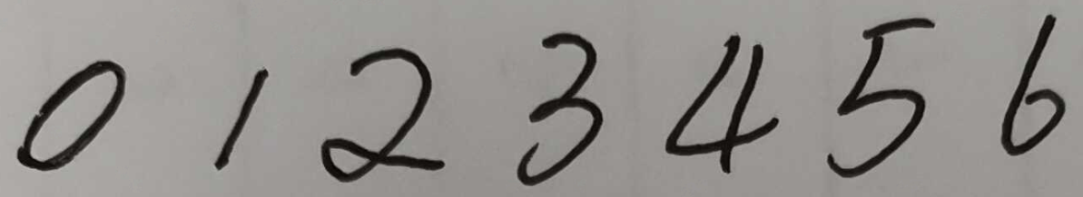

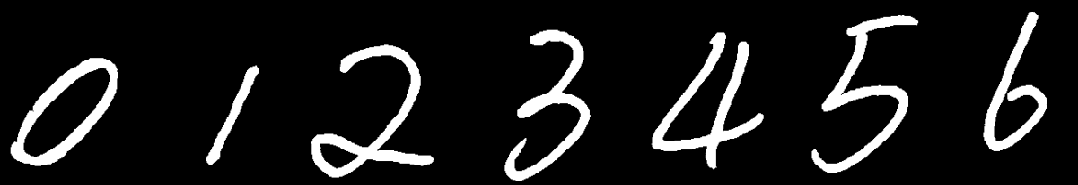
[[0 0 0 0 0 0 0 0]
[0 0 1 1 1 0 0 0]
[0 1 0 0 0 1 0 0]
[0 0 0 1 1 0 0 0]
[0 0 0 0 0 1 0 0]
[0 1 0 0 0 1 0 0]
[0 0 0 0 0 0 0 0]]
trainData
[0 0 0 0 0 0 0 0 0 0 1 1 1 0 0 0...0]
Training
Detect
ret,result,neighbours,dist = knn.findNearest(img,k=1)
Segmentation range
[[0 0 1 1 1 1 1 0]
[0 1 0 0 0 0 0 1]
[1 0 0 0 0 0 1 0]
[0 0 0 1 1 1 0 0]
[1 0 0 0 0 0 1 0]
[0 1 0 0 0 0 1 0]
[0 0 1 1 1 1 0 0]]
userData
[0 0 1 1 1 1 1 0 0 1 0 0 0 0 0 1...0]
ret, imgBin = cv2.threshold(img, Threshold, maxval,type)
What is working?

Slide 3
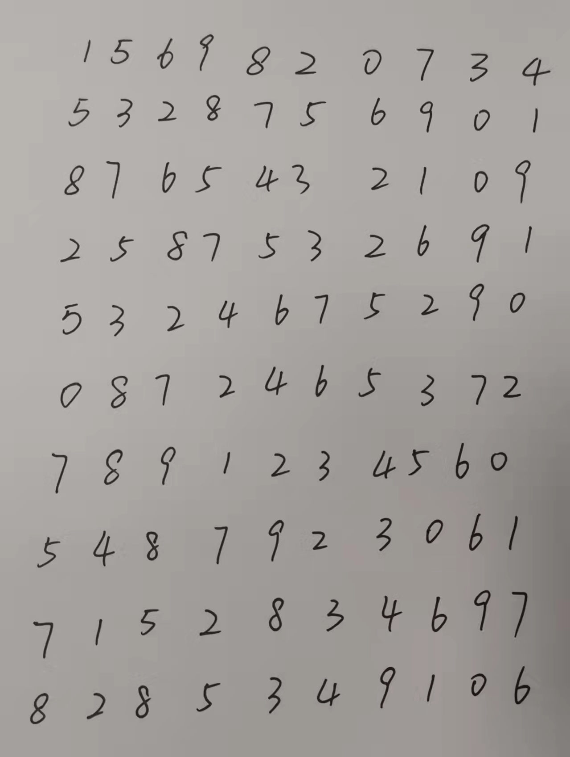
Multiple Lines

